Slide 1

Unearthing Concurrency Bugs in Cloud-Scale Distributed Systems
Tanakorn Leesatapornwongsa
Advisor: Haryadi S. Gunawi
Committee: Shan Lu, Ravi Chugh

Slide 2



Research
Interest: distributed systems & OSes
Focus: cloud/datacenter infrastructure
Research: improving dependability of cloud-scale distributed systems
Data-parallel
framework
Distributed file system
Scalable data store

Slide 3













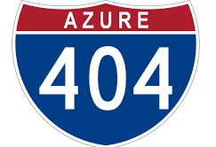




Single-machine software
Small-scale distributed systems
Cloud-scale distributed systems
Why they fail?
What are new critical bugs?
How to combat them?
…
programming language support, empirical bug study, bug detections by program analysis, deadlock detection, testing coverage-criteria design, failure reproduction and diagnosis, hot-patching systems, failure prevention,
My research
Notes:
Probably, create a box to show all work on dependability of single machine software e.g. klee, rx, conair, …

Slide 4
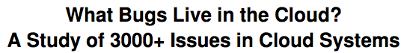
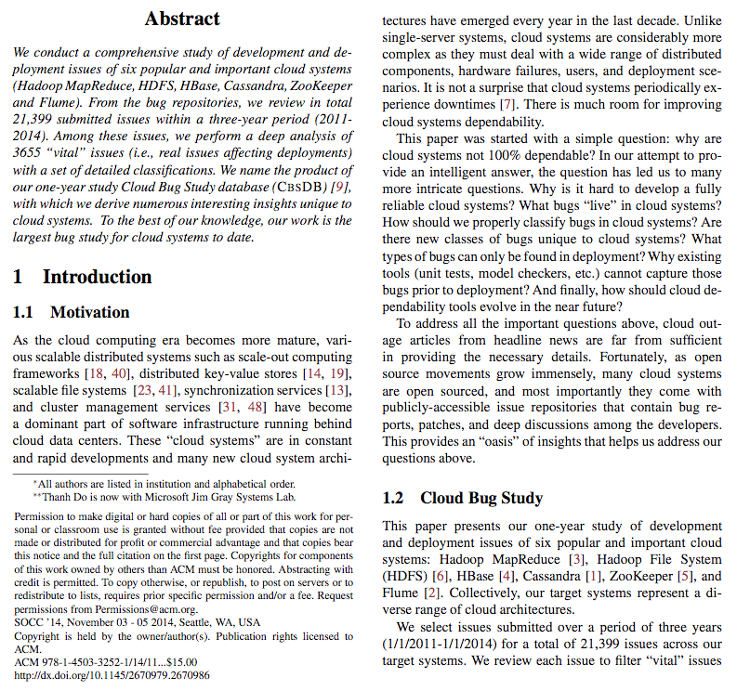
New Critical Bugs?
# of Bug Reports | Jan 2017
Hadoop/Yarn | 26817
HDFS | 11279
HBase | 17398
Cassandra | 13083
ZooKeeper | 2657
Flume | 3037
@ SoCC ’14
Thousands of
public bug reports

Slide 5
New Critical Bugs!
SAMC [OSDI ’14]
TaxDC [ASPLOS ’16]
Distributed concurrency bugs
Concurrent message interleaving
Timing of multiple faults

Slide 6
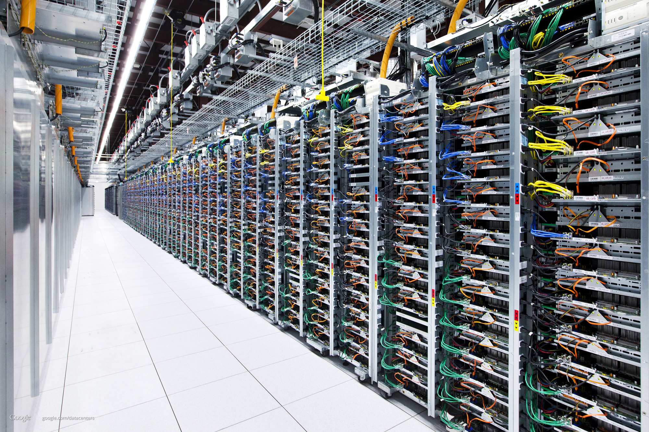
New Critical Bugs!
SAMC [OSDI ’14]
TaxDC [ASPLOS ’16]
Distributed concurrency bugs
Concurrent message interleaving
Timing of multiple faults
Scalability bugs
SCk [HotOS ’17]

Slide 7
New Critical Bugs!
SAMC [OSDI ’14]
TaxDC [ASPLOS ’16]
Distributed concurrency bugs
Concurrent message interleaving
Timing of multiple faults
Scalability bugs
Partial-failure induced performance bugs
Other bugs
Today talk
SCk [HotOS ’17]
Path-Based Spec. Exec [In sub.]
Limpware [SoCC ’13]
PhD work

Slide 8

Distributed concurrency (DC) bugs
Caused by non-deterministic timing of concurrent events involving more than one node
Events: Messages, local computations, crashes, reboots, timeouts
Data loss, downtimes,
inconsistent replicas,
hanging jobs, etc.

Slide 9
DC bug: a simple view

Slide 10
DC bug: a real view
Cassandra Paxos Bug (# 6023)
3 concurrent updates
Red, blue, green
3 msg-msg races must happen
m = prepare message for ballot 2, BEFORE
n = commit message for ballot 1
o = prepare message for ballot 3, BEFORE
p = propose message for ballot 2
q = promise message for ballot 3, BEFORE
r = promise message for ballot 3
(24 hours to understand)

Slide 11

A
B
C
ZooKeeper (synchronization service)
Issue #335.
1. Nodes A, B, C start (w/ latex txid: 10)
2. B becomes leader
3. B crashes
4. C becomes leader
5. C commits new txid-value pair (11, X)
6. A crashes, before committing (11, X)
7. C loses quorum and C crashes
8. A and B are back online
9. A becomes leader
10. A's commits new txid-value pair (11, Y)
11. C is back online
12. C announces to B (11, X)
13. B replies the diff from tx 12
14. Inconsistency: A has (11, Y), C has (11, X)
F
L
F
F
L
x
F
L
x
L
x
x
L
F
y
y
x
L
F
y
y
x
L
F
F
PERMANENT INCONSISTENT REPLICA
Notes:
So how deep the bugs could be?
Let me give you a real story from ZooKeeper. ZooKeeper is a synchronization service, which every node is supposed to maintain the consistent data.

Slide 12
ZooKeeper (synchronization service)
Issue #335.
1. Nodes A, B, C start (w/ latex txid: 10)
2. B becomes leader
3. B crashes
4. C becomes leader
5. C commits new txid-value pair (11, X)
6. A crashes, before committing (11, X)
7. C loses quorum and C crashes
8. A and B are back online
9. A becomes leader
10. A's commits new txid-value pair (11, Y)
11. C is back online
12. C announces to B (11, X)
13. B replies the diff from tx 12
14. Inconsistency: A has (11, Y), C has (11, X)
1. Out-of-order messages
2. Multiple crashes
Specific Order
3. Multiple reboots
HAPPEN IN ANY ORDER
1
2
3
Notes:
First, the system generates lots of messages that can arrive out of order
Second, the system faces multiple crashes
And third, after crashes, some nodes reboot

Slide 13
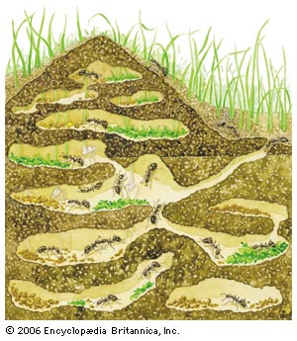
How can we catch complex DC bugs in distributed systems?
Notes:
So the big question is how do we catch deep bugs in distributed systems?

Slide 14
Model Checker for Distributed Systems
Control timing of non-deterministic events
Concurrent messages: a, b, c, d
Test all possible event interleavings
Interleavings: abcd, abdc, acbd, acdb, …
Software/impl-level, not model-based
Model checker

Slide 15


Event Re-ordering
Find buggy path
3
4
1
5
2
6
7
8
9
12
11
10
14
13
2
7
1
4
5
6
3
8
11
10
9
12
14
13
6
9
3
4
5
1
7
8
2
10
11
13
12
14
1
2
3
4
5
6
7
8
9
10
11
12
13
14
2
1
3
4
5
7
6
8
9
10
11
14
12
13
. . .
Notes:
One approach is to use distributed system model checker. What does model checker do? Basically, given all distributed events, model checker will re- order them and find which one that lead to bugs.

Slide 16
SAMC: Semantic-Aware Model Checking for Fast Discovery of DC Bugs [OSDI ’14]
Notes:
So the big question is how do we catch deep bugs in distributed systems?

Slide 17
What’s Wrong with Existing Model Checkers?
Last 10 years
MaceMC, Modist, Demeter, dBug, etc.
BUT
Too many events
State space explosion
Multiple crashes and reboots
Create more messages
No model checker incorporate
multiple crashes and reboots
Cannot catch complex bugs!
100 events
Notes:
In the past nine years, we have seen a rise of distributed system model checker such as Modist, MaceMC, and Demeter.

Slide 18
How can we catch DC bugs REALLY FAST?
Notes:
So the real question is how to catch deep bugs really fast.

Slide 19
Simple reduction technique
Not re-order messages sent to different nodes
N1
N2
Brute force
ABCD
ABDC
ACBD
ACDB
ADBC
. . .
(24 total)
A B C D
N1: A B
N2: C D
A C B D
N1: A B
N2: C D
Same result
B
C
A
D
N3

Slide 20
Black-Box Approach
Treat target systems as black boxes
Messages to the same node can be great
Model checkers are still slow
Not help in crashes & reboots
Black Box Model Checker
ABCD
ABDC
ACBD
ACDB
. . .
(24 total)
Black
Box
A
B
C
D
Notes:
The model checkers are slow because they treat the system as a black box.
What do I mean by that?
Let see this example, when we have a node with 4 concurrent messages, a model checker must permute all possible ordering as you can see here.

Slide 21
How can Model Checker be Faster?
Exploit semantic knowledge
E.g. knowledge of how messages are processed
Semantic-aware model checker (SAMC)
Receive semantic knowledge from developers
Reduce number of re-ordering
Black
Box
Semantic
Awareness
A
B
C
D
A
B
C
D
Notes:
So how can we make model checker faster?
What I’m going to say is that if we open the black box and use some semantic knowledge, we reduce the number of re-orderings.

Slide 22
Dependency vs. Independency
A, B
S’
Node
State = S
A, B
S
S
S’
S’’
B, A
B, A
A
B
Unnecessary
A, B = Dependent
A, B = Independent
Independent = No need to reorder
Notes:
Okay, so the main goal here is to reduce unnecessary re-orderings.
We can safely do so using the notion of dependency and independency, from the model checking literature. Let me show you how this works.

Slide 23
Black Box vs. SAMC
Black Box Model Checker
ABCD
ABDC
ACBD
ACDB
ADBC
ADCB
BACD
BADC
BCAD
BCDA
BDAC
. . .
SAMC with message processing semantic
ABCD
ABDC
ACBD
ACDB
ADBC
ADCB
BACD
BADC
BCAD
BCDA
. . .
Black
Box
Message
Processing
Semantic
A
B
C
D
A
B
C
D
All dependent
Dep.
Dep.
Unnecessary
Re-orderings
(lead to the same
state)
Notes:
Here if we treat a node as a black box, we do not know which re-orderings lead to the same state,
because we do not know how these messages will af- fect the local state.
We need to treat all messages as dependent! And the model checker needs to re-order everything, giving us 4!, or 24 re-orderings.

Slide 24
Leader Election Semantic
1, 2, 3
1, 3, 2
2, 1, 3
B = 4
B = 4
B = 4
ballot = 4
V = 1
V = 1
V = 2
if(vote <= ballot)
// do nothing
else
ballot = vote;
B = 4
B = 4
B = 4
. . .
Unnecessary
V = 2
V = 3
V = 1
B = 4
B = 4
B = 4
V = 3
V = 2
V = 3
Vote=1
Vote=2
Vote=3
B = 4
B = 4
B = 4
24
Notes:
So how can we find independent events? Message processing semantic will help us here.
Consider this example of simplified leader election protocol.
When a leader election takes place, every node has its own ballot which the node wants to choose as a leader.

Slide 25
Discard pattern
MESSAGE PROCESSING SEMANTIC
if (vote <= ballot)
// do nothing
else
ballot = vote;
DISCARD PATTERN
if (isDiscard(msg, state))
// do nothing;
}
DISCARD PREDICATE
boolean discardPredicate(msg, st) {
if (msg.vote <= st.ballot)
return true;
else
return false;
}
Notes:
Now, let me formalize our techniques here with con- crete steps.
First, given a message processing semantic, we ASK: is there a generic pattern here?
The answer is yes, this is a pattern that we call as a discard pattern.

Slide 26
Local-Message Independence (LMI)
Discard pattern
Increment pattern
Constant pattern
C=0
C=0
if (msg.type == ack) {
node.ackCount++;
}
ack
ack
boolean incrementPredicate(msg, st) {
if (msg.type == ack)
return true;
else
return false;
}
C=1
C=1
ack
ack
C=2
C=2
Notes:
Now, let me formalize our techniques here with con- crete steps.
First, given a message processing semantic, we ASK: is there a generic pattern here?
The answer is yes, this is a pattern that we call as a discard pattern.

Slide 27
SAMC with Crashes
Black Box Model checker
ABCDX
ABCXD
ABXCD
AXBCD
XABCD
ABDCX
ABDXC
. . .
SAMC with crash recovery semantic
ABCDX
ABCXD
ABXCD
AXBCD
XABCD
ABDCX
ABDXC
. . .
Crash
Recovery
Semantic
N2
A,B
N1
N3
C,D
Unnecessary
Re-orderings
N4
Notes:
As I’ve mentioned, to hit deep bugs, we need to excer- cise crash and reboot.
So consider the case that we are injecting a crash la- beled with X here?

Slide 28
Crash Recovery Semantic
L
void handleCrash() {
if (X == follower && isQuorum())
followerCount--;
// No new messages !!
}
Black Box
ABCDX
ABCXD
ABXCD
AXBCD
XABCD
ABDCX
…
A,B
C,D
F
F
F
Crash a follower → Local Impact
(no new messages &
only state changes in leader L)
Notes:
Look at replication protocol in this leader-follower ar- chitecture.
What happen if we crash the follower and there are outstanding messages ABCD to the other followers?

Slide 29
Crash Recovery Semantic
L
void handleCrash() {
if (X == leader || !isQuorum())
electLeader()
// New messages created
}
A,B
C,D
F
F
F
Black Box
ABCDX
ABCXD
ABXCD
AXBCD
XABCD
ABDCX
…
Crash the leader
→ Global Impact
(cannot prune
re-orderings)
L
S
S
S
Notes:
BUT, say we inject a crash on the leader, then this crash event will create new messages, so this is a GLOBAL impact. so this crash MUST be reordered with other messages, and this is a rule.

Slide 30
SAMC (~ 10 KLOC)
Protocol
Specific
Reduction
Predicates
Leader
Election
Atomic
Broadcast
…
…
~35 LOC / protocol
Generic Reduction Patterns
Local-Message
Indep. (LMI)
Crash-Message
Indep. (CMI)
Crash Recovery
Symmetry (CRS)
Reboot Sync.
Symmetry (RSS)
Mechanisms:
Workload Drivers
Message interceptors
Fault injections
Path explorers:
DFS, DPOR
Setup: boot, cleanup
Notes:
Like other model checker.

Slide 31
Protocol-Specific Rules (e.g. ZooKeeper Leader Election)
35 LOC on average per protocol
Notes:
This is an example of protocol-specific rules from ZooKeeper leader election.
On average, it takes 35 lines of code for each proto- cols.

Slide 32
Catching Old Bugs
A table shows number of executions to reach the bugs and speedup
Issue#
ZooKeeper-335
ZooKeeper-790
ZooKeeper-975
ZooKeeper-1075
ZooKeeper-1419
ZooKeeper-1492
ZooKeeper-1653
MapReduce-4748
MapReduce-5489
MapReduce-5505
Cassandra-3395
Cassandra-3626
SAMC
#exe
117
7
53
16
100
576
11
4
53
40
104
96
Black-Box DPOR
#exe | speedup
5000+
14
967
1081
924
5000+
945
22
5000+
1212
2552
5000+
Random
#exe | speedup
1057
225
71
86
2514
5000+
3756
6
5000+
5000+
191
5000+
Random DPOR
#exe | speedup
5000+
82
163
250
987
5000+
3462
6
5000+
1210
550
5000+
Notes:
I used SAMC to re-produce 12 old bugs in 3 systems, zookeeper, hadoop, and cassandra.
I compare it with other state-of-the-art techniques, black-box dynamic partial order reduction that uses the notion of dependency but no domain-specific knowledge, random reordering, and random dynamic partial order reduction that is a combination of both of them.

Slide 33
Catching Old Bugs
Issue#
ZooKeeper-335
ZooKeeper-790
ZooKeeper-975
ZooKeeper-1075
ZooKeeper-1419
ZooKeeper-1492
ZooKeeper-1653
MapReduce-4748
MapReduce-5489
MapReduce-5505
Cassandra-3395
Cassandra-3626
SAMC
#exe
117
7
53
16
100
576
11
4
53
40
104
96
Black-Box DPOR
#exe | speedup
5000+ | 43+
14 | 2
967 | 18
1081 | 68
924 | 9
5000+ | 9+
945 | 86
22 | 6
5000+ | 94+
1212 | 30
2552 | 25
5000+ | 52+
Random
#exe | speedup
1057 | 9
225 | 32
71 | 1
86 | 5
2514 | 25
5000+ | 9+
3756 | 341
6 | 2
5000+ | 94+
5000+ | 125+
191 | 2
5000+ | 52+
Random DPOR
#exe | speedup
5000+ | 43+
82 | 12
163 | 3
250 | 16
987 | 10
5000+ | 9+
3462 | 315
6 | 2
5000+ | 94+
1210 | 30
550 | 5
5000+ | 52
Notes:
The speedup I gain is from 2x to 340x, and it is 49x on average.

Slide 34
SAMC (Summary)
Model checker is used to catch DC bugs
BUT state space explosion
Semantic awareness is powerful!
Detecting unnecessary reordering
2x – 340x speedup, 49x on average
Notes:
To summarize, deep DC bugs do happen to the sys- tems.
Distributed system model checker is used to catch DC bugs, but state-space explosion happens.
And I prove here that with SIMPLE semantic knowl- edge, we can detect unnecessary re-ordering, which we can skip, and will gain 2 - 340x speedup.

Slide 35
TaxDC: Taxonomy of Non-Deterministic Concurrency Bugs in Datacenter Distributed Systems [ASPLOS ’16]
Notes:
And that’s all about SAMC.

Slide 36



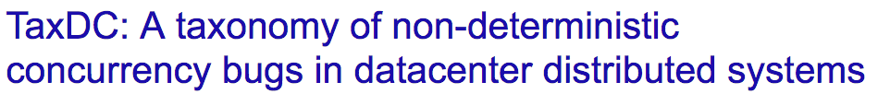
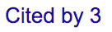
(Local concurrency bug: multi-threaded single machine software)
Top 10 most cited ASPLOS paper
Notes:
Bug studies can significantly guide dependability re- search.
If we search for local concurrency bugs or LC bugs, which are bugs in multithreading software. There is a paper studying about them. This paper has been cited hundreds times and is a top 10 most cited ASPLOS paper.

Slide 37

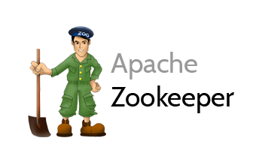
TaxDC
Taxonomy of DC bugs
104 bugs
4 varied distributed systems
Bugs in 2011-2014
Study description, source code, patches
Notes:
I started TaxDC project which I created taxonomy of DC bugs.
Here I studied 104 bugs,

Slide 38
Detailed Characteristics
ZooKeeper-1264
1. Follower F crashes, reboots, and joins cluster
2. Leader L sync snapshot with F
3. Client requests new update, F applies this only in memory
4. Sync finishes
5. Client requests other update, F writes this to disk correctly
6. F crashes, reboots, and joins cluster again
7. This time L sends only diff after update in step 5.
8. F loses update in step 3.
Timing:
- Atomicity
violation
- Fault Timing
Input:
- 4 Protocols
- 2 faults
- 2 reboots
Error:
- Global
Failure:
Data inconsistency
Fix:
Delay msg.
Notes:
The first thing I want to tell you is that.
Creating taxonomy is not straightforward.
I had to define new detailed characteristics that will help future dependability research.
And here are all characteristic that I studied

Slide 39
Contribution:
TaxDC
Trigger
Error & Failure
Fix
Timing
Input
Scope
Order Violation
Atomicity Violation
Fault Timing
Reboot Timing
Fault
Reboot
Workload
Nodes
Messages
Protocols
Error
Failure
Loc Mem
Loc Sem
Loc Hang
Loc Silence
Glob Wrong
Glob Silence
Glob Miss
Downtime
Data Loss
Op Fail
Performance
Timing
Handling
Global Sync
Local Sync
Retry
Ignore
Accept
Others
Timing
Input
Scope
Error
Failure
Timing
Handling
Notes:
Which lead to this full taxonomy. And I’ll discuss some of them here.

Slide 40
TaxDC
Trigger
Error & Failure
Fix
Timing
Input
Scope
Order Violation
Atomicity Violation
Fault Timing
Reboot Timing
Fault
Reboot
Workload
Nodes
Messages
Protocols
Error
Failure
Loc Mem
Loc Sem
Loc Hang
Loc Silence
Glob Wrong
Glob Silence
Glob Miss
Downtime
Data Loss
Op Fail
Performance
Timing
Handling
Global Sync
Local Sync
Retry
Ignore
Accept
Others
Timing
Input
Scope
Error
Failure
Timing
Handling
Conditions that induce the bugs
Notes:
Start with trigger. Trigger is conditions that make bugs happen.

Slide 41
TaxDC
Trigger
Error & Failure
Fix
Timing
Input
Scope
Order Violation
Atomicity Violation
Fault Timing
Reboot Timing
Fault
Reboot
Workload
Nodes
Messages
Protocols
Error
Failure
Loc Mem
Loc Sem
Loc Hang
Loc Silence
Glob Wrong
Glob Silence
Glob Miss
Downtime
Data Loss
Op Fail
Performance
Timing
Handling
Global Sync
Local Sync
Retry
Ignore
Accept
Others
Timing
Input
Scope
Error
Failure
Timing
Handling
What: Untimely moment
that makes bug happens
Why: Help design
bug detection tools
Notes:
Here, we will look at timing condition.
Timing condition is an untimely moment that makes bug happens. Understanding timing helps design de- tection tools.

Slide 42
Trigger
Timing
Message
“Does the timing
involve many messages?”
Ex: MapReduce-3274
Notes:
DC bugs are triggered by message timing or fault timing.
Look at message timing first.
In a distributed operation, it involves many events. First we think to hit a bug, it’s about the ordering of many events. Like 10 events must be in an exact order.

Slide 43
Trigger
Timing
Message
Order violation (44%)
“Does the timing
involve many messages?”
2 events, X and Y
Y must happen after X
But Y happens before X
Ex: MapReduce-3274
Notes:
But that’s not true, let look at this pattern that I call order violation.
This pattern only involves 2 events, X and Y. X must happen before Y, but X can happen after Y.

Slide 44

Trigger
Kill
Submit
Timing
Message
Order violation (44%)
Msg-msg race
“Does the timing
involve many messages?”
Kill
Submit
2 events, X and Y
Y must happen after X
But Y happens before X
Ex: MapReduce-3274
Notes:
Here is order violation that is from a case of simple message-message race.
This line is a timeline of a node.
Here, job-submit arrives at the node, and then job-kill. The node kill job correctly.
This looks simple but actually in our study, message- message race can come in different complex forms.
Here what I’ve just shown you receive-receive race.

Slide 45
Trigger
A
B
A
B
Kill
Timing
New
key
Message
Order violation (44%)
Msg-msg race
New
End report
A
B
A
B
Old
key
Kill
End report
New
key
(late)
Expired!
Kill
what
job?
Receive-receive
race
Receive-send
race
Send-send
race
MapReduce-3274
HBase-5780
MapReduce-5358
Notes:
This looks simple but actually in our study, message- message race can come in different complex forms.
Here what I’ve just shown you receive-receive race.

Slide 46
Trigger
Timing
cmp
Message
Order violation (44%)
Msg-msg race
Msg-compute race
Order violation:
2 events, X and Y
Y must happen after X
But Y happens before X
cmp
Ex: MapReduce-4157
Notes:
Well, interestingly, order violation is not just message- message race, we could also have message-compute race.

Slide 47
Trigger
A
B
A
B
Timing
Message
Order violation (44%)
Atomicity
violation (20%)
A
B
A message comes in
the middle of atomic operation
Ex: Cassandra-1011, Hbase-4729, MapReduce-5009, Zookeeper-1496
Notes:
The next message timing is atomicity violation, which takes 20%.

Slide 48
Trigger
A
B
A
B
C
Timing
Message
Fault (21%)
Fault at specific timing
A
B
C
No fault timing in local concurrency
Only in DC bugs
Ex: Cassandra-6415, Hbase-5806, MapReduce-3858, Zookeeper-1653
Notes:
Okay, those’re message timing bugs, but there is also fault timing, which take 21%.
Because fault is expected in distributed systems. And it happens at very very specific timing, we’ll get a problem.
There is no fault timing in LC bugs, this is only in DC bugs.

Slide 49


A
B
Trigger
Timing
Message
Fault
Reboot (11%)
A
B
Reboot at specific timing
Ex: Cassandra-2083, Hadoop-3186, MapReduce-5489, Zookeeper-975
Notes:
Okay, we also have reboot timing bugs which are similar to fault timing. So I’ll skip it.

Slide 50
Trigger
Implication: simple patterns can inform
pattern-based bug detection tools, etc.
Timing
cmp
cmp
Message timing
Fault timing
Reboot timing
Notes:
So, in summary, DC bugs have different forms of tim- ing violations.
Here, DC bugs are complex, but we can abstract all of them with only these timing patterns.
Understanding this helps us building pattern-based bug detection tools for DC bugs.

Slide 51
TaxDC
Trigger
Error & Failure
Fix
Timing
Input
Scope
Order Violation
Atomicity Violation
Fault Timing
Reboot Timing
Fault
Reboot
Workload
Nodes
Messages
Protocols
Error
Failure
Loc Mem
Loc Sem
Loc Hang
Loc Silence
Glob Wrong
Glob Silence
Glob Miss
Downtime
Data Loss
Op Fail
Performance
Timing
Handling
Global Sync
Local Sync
Retry
Ignore
Accept
Others
Timing
Input
Scope
Error
Failure
Timing
Handling
What: Input to
exercise buggy code
Why: Improve
testing coverage
Notes:
Now let me tell you about input condition
Input condition is input to exercise buggy code

Slide 52
Trigger
Timing
“How many bugs require fault injection?”
Input
37% = No fault
63% = Yes
Fault
“What kind of fault? & How many times?”
88% = No timeout
12%
53% = No crash
35% = 1 crash
12%
Real-world DC bugs are NOT just about
message re-ordering, but faults as well
Notes:
The first question we ask for the input is that “HOW MANY bugs require fault injection in order to reveal them?”
Here it shows that 63% require some fault injections to manifest.
Then “what kinds of faults should we inject and how many times?”

Slide 53
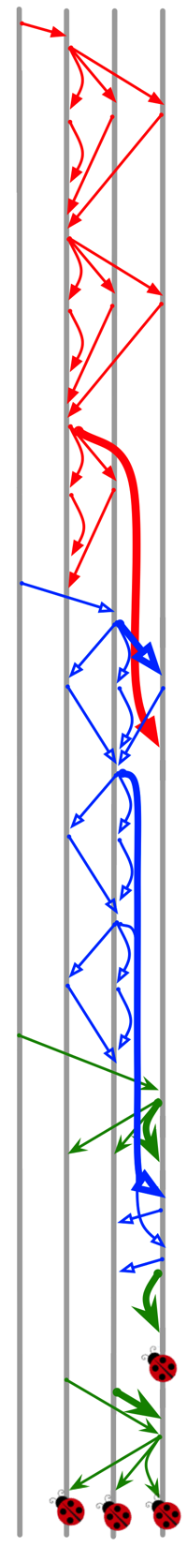
Trigger
Cassandra Paxos bug
(Cassandra-6023)
3 concurrent user requests!
“How many protocols to run as input?”
Timing
Input
Fault
Workload
n
m
20% = 1
80% = 2+ protocols
p
o
Implication: multiple protocols
for DC testing
r
q
Notes:
Well, the next input condtion is workload to excercise buggy code.
Let’s look at this Cassandra Paxos bug. Don’t worry the detail, but what happens is that M happens after N, O happens after P, and Q happens after R.

Slide 54
TaxDC
Trigger
Error & Failure
Fix
Timing
Input
Scope
Order Violation
Atomicity Violation
Fault Timing
Reboot Timing
Fault
Reboot
Workload
Nodes
Messages
Protocols
Error
Failure
Loc Mem
Loc Sem
Loc Hang
Loc Silence
Glob Wrong
Glob Silence
Glob Miss
Downtime
Data Loss
Op Fail
Performance
Timing
Handling
Global Sync
Local Sync
Retry
Ignore
Accept
Others
Timing
Input
Scope
Error
Failure
Timing
Handling
What: How developers fix bugs
Why: Help design runtime prevention
and automatic patch generation
Notes:
Now let me talk about the fixes.
Understanding this will help us identify opportunities for runtime prevention and patch generation.

Slide 55
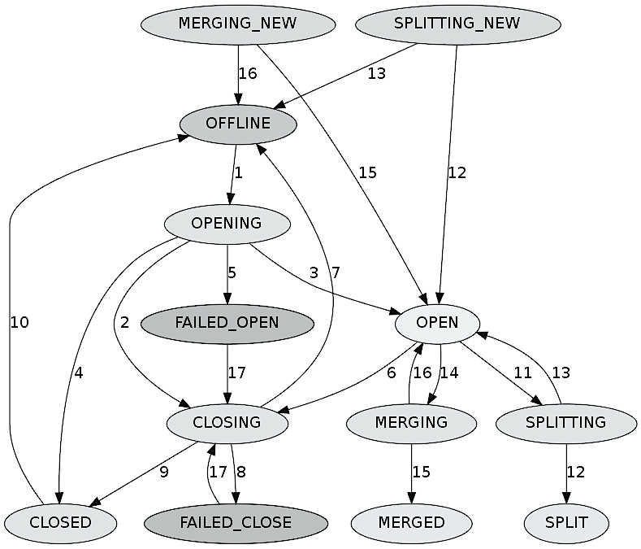
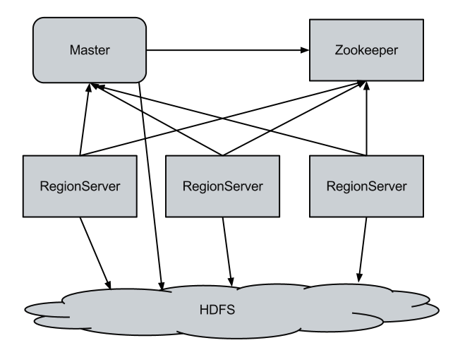
Trigger
Error
Add new states
& transitions
Fix
Complex
Are patches complicated?
Are patches adding synch.?
Add
Global
Sync.
Similar to fixing local concurrency bugs:
add synchronization
e.g. lock()
Notes:
first, when I first started this study, I thought that fixes for DC bugs must be very complex.
Yes, some fix add new states and transitions, some add global synchronization which is similar to fixing LC bugs by adding lock

Slide 56
Trigger
Error
Fix
Complex
Simple
Delay
Notes:
But I see many bugs have simple fixes.
For example, we still have untimely message, but we DELAYS processing until this black message come.

Slide 57

Trigger
Error
Fix
Complex
Simple
Delay
Ignore/discard
Notes:
Sometime, fixes just IGNORE untimely messages, and sometime it’s safe to do that.

Slide 58
Trigger
Error
Fix
Complex
Simple
Delay
Ignore/Discard
Retry
Notes:
This case message come too early. It get rejected. Sender retry sending message again

Slide 59
Trigger
Error
Fix
f(msg);
Complex
g(msg);
Simple
Delay
Ignore/Discard
Retry
Accept
Notes:
Or we can change handler method of untimely mes- sage from function F to to existing function G.

Slide 60
Trigger
Error
Fix
Complex
Simple
Delay
Ignore
40% are easy to fix
(no new computation logic)
f(msg);
g(msg);
Implication:
many fixes can inform
runtime failure
prevention
Retry
Accept
Notes:
a good news here is 40% of bugs can be fixed with very easy fixes like this, which no new computa- tion logic is introduced.

Slide 61
Challenges & Opportunities in …
Distributed system model checker
Formal verification
DC bug detection
Runtime failure prevention
Notes:
Okay, TaxDC is bug study. And for all bug studies, people will ask, “SO WHAT?”
From the study we can see opportunities and chal- lenges when we review these literature in combating DC bugs.

Slide 62

Distributed System Model Checker
Event
Message
Crash
Multiple crashes
Reboot
Multiple reboots
Timeout
Computation
Disk fault
Modist NSDI’11 | Demeter SOSP’11 | MaceMC NSDI’07 | SAMC OSDI’14
Reality
State-space explosion
Notes:
So let’s start with distributed systems model checker.
You can see that we have many distributed events, messages, faults, reboot, and computation.
SAMC and other existing works just re-order some events.

Slide 63
Formal Verification
State-of-the-art
Verdi
Raft update
IronFleet
Paxos update
Lease-based read/write
Challenges
Foreground & Background
#Protocol interactions
19%=FG
52% = BG
29% = Mix
Only verify foreground protocols
20%=1
80% = 2+ Protocols
Foreground
& background
Verify interactions among various protocols
Notes:
Today, we have much advancement in formal verifica- tion of distributed systems. But so far we only verify FOREGROUND protocols such as read and write.

Slide 64
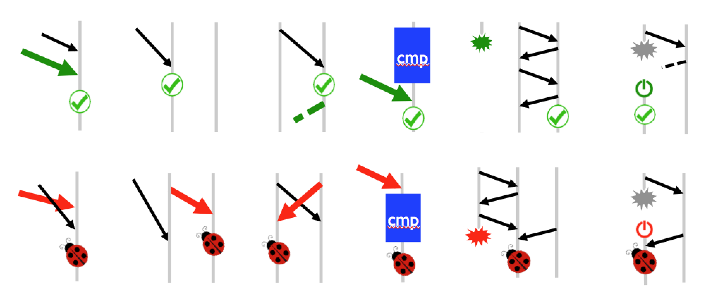
DC Bug Detection
State-of-the-art: Local bug detection
Pattern-based detection
Error-based detection
Statistical bug detection
Opportunities: DC bug detection?
Pattern-based detection
Error-based detection
Opportunity for
DC bug detection
Notes:
For bug detection, we have plentiful tools on LC bugs that look for buggy code patterns.
TaxDC shows that all DC bugs can be covered by these patterns.
So, “Let’s leverage these timing patterns and explicit error to do DC bug detection”

Slide 65
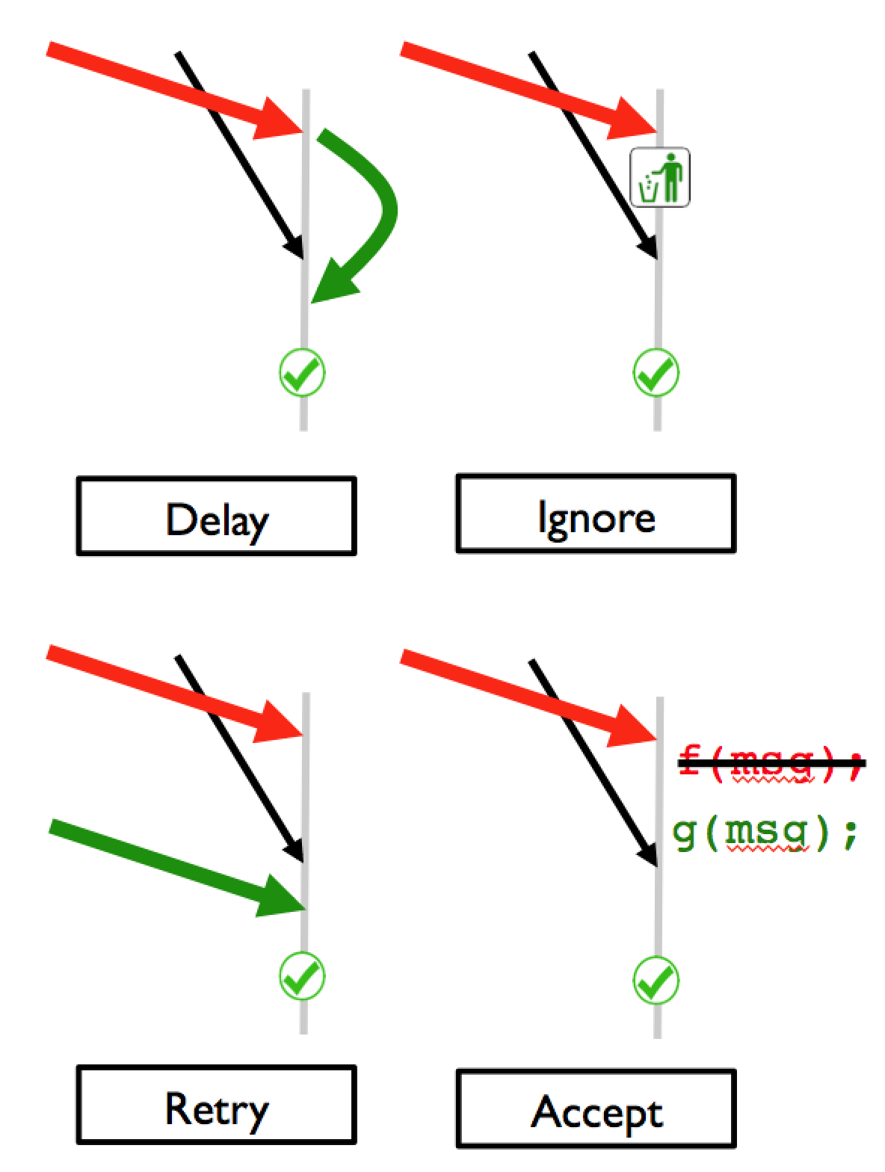
Runtime Failure Prevention
State-of-the-art: Local bug prevention
Deadlock Immunity
Aviso
ConAir
Etc.
Opportunities: DC bug prevention
Fixes
60% = Complex
40% = Simple
Opportunity for
runtime failure prevention
Notes:
For runtime failure prevention. We have successful tools that inject delays at runtime to prevent LC bugs.
And reality shows that 40% of DC bugs have SIMPLE fixes.

Slide 66
TaxDC (Summary)
DC bugs are very complex
Developers' complaints on DC bugs
More challenges and opportunities are waiting!
“There isn’t a week going by without some new bugs about races between splitting and assignment [distributed protocols].” — hbase4397
“That is one monster of a race!” — mr3274
“This has become quite messy, we didn’t foresee some of this during design, sigh.” — mr4819
“Great catch, Sid! Apologies for missing the race condition” — mr4099
“We have already found and fix many cases ... however it seems exist many other cases.” — hb6147
Notes:
So in conclusion,

Slide 67
New Critical Bugs!
SAMC [OSDI ’14]
TaxDC [ASPLOS ’16]
Distributed concurrency bugs
Concurrent message interleaving
Timing of multiple faults
Scalability bugs
Partial-failure induced performance bugs
Other bugs
SCk [HotOS ’17]
Path-Based Spec. Exec [In sub.]
Limpware [SoCC ’13]
PhD work

Slide 68
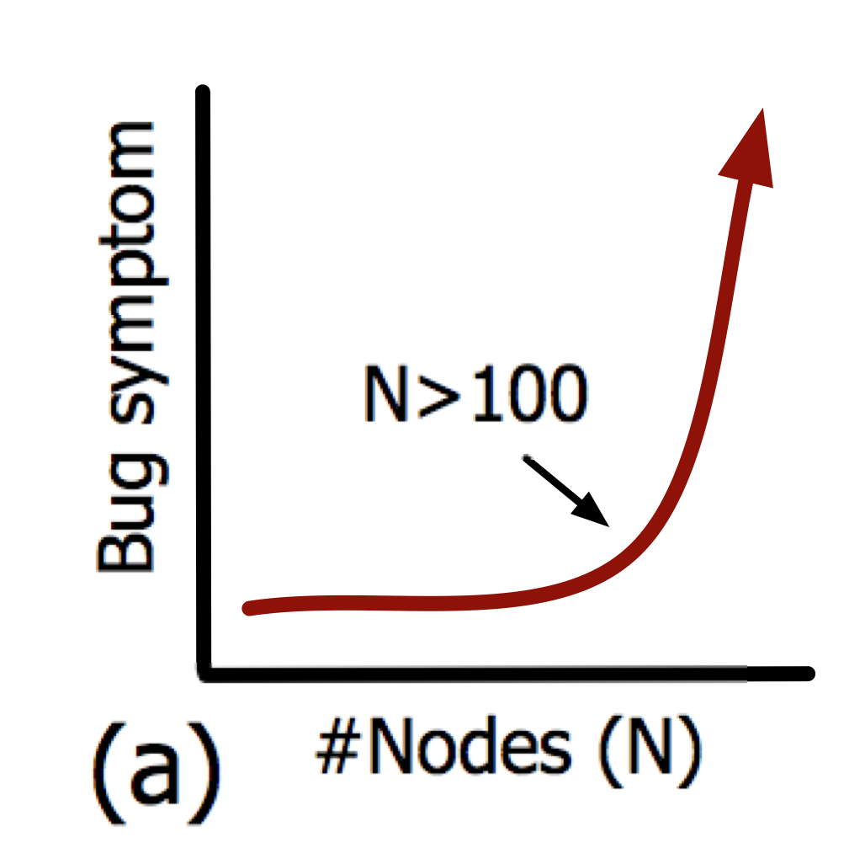
Scalability Bugs
Latent bugs that are scale dependent
Surface in large-scale deployments
e.g., ≥100 nodes

Slide 69
Scalability Bug Combating
Understanding, finding, testing and debugging
Studying 41 bugs in 7 systems
CPU-intensive (e.g., O(n³))
I/O-intensive (e.g., O(n))
Cascading effects of offensive functions
Large scale emulation

Slide 70
SCk Techniques
Methodology to scale-check systems
… on just one machine
Resource contention
CPU, memory, thread
4 techniques to reduce resource contention
Processing illusion (CPU contention)
Single process cluster (memory & context switching)
Global-event driven architecture (thread & context sw.)
Memory footprint reduction (memory)

Slide 71
Evaluation
Integrate to Cassandra, Riak, Voldemort
#False failure detection (x1000)
Time period between 2 heartbeats (s)
Cluster size (#nodes)
Cluster size (#nodes)
Partition table merging time (ms)
Cluster size (#nodes)
Notes:
For failure detection bug in Cassandra, the parameters are the number of false detection, the period between 2 heartbeats that the node has received, and table merg- ing time.
You can see from the graph, the number we got are similar to the real run.
I try this with 6 old bugs, and the result from SCk can indicate bug symtomp as I run in the real cluster.
I also find a new potential bug in Cassandra

Slide 72
New Critical Bugs!
SAMC [OSDI ’14]
TaxDC [ASPLOS ’16]
Distributed concurrency bugs
Concurrent message interleaving
Timing of multiple faults
Scalability bugs
Partial-failure induced performance bugs
Other bugs
SCk [HotOS ’17]
Path-Based Spec. Exec [In sub.]
Limpware [SoCC ’13]
PhD work

Slide 73
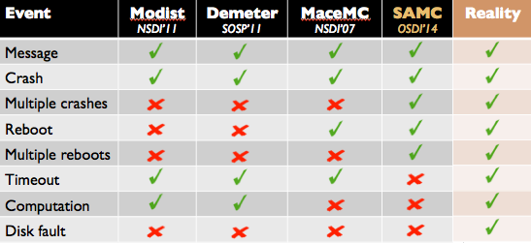
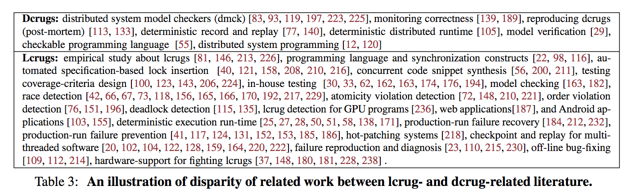
Future Work (DC Bugs)
Unassisted model checker
50 %
More complete
More reduction
Other techniques
Bug detection, runtime prevention, etc.

Slide 74
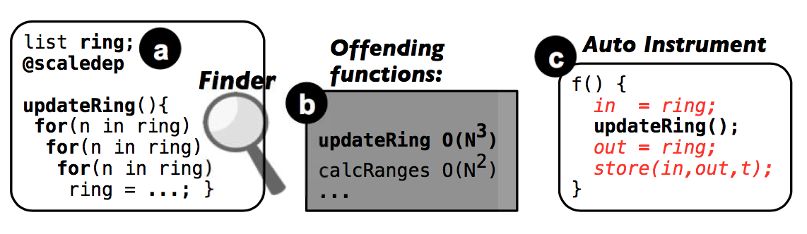
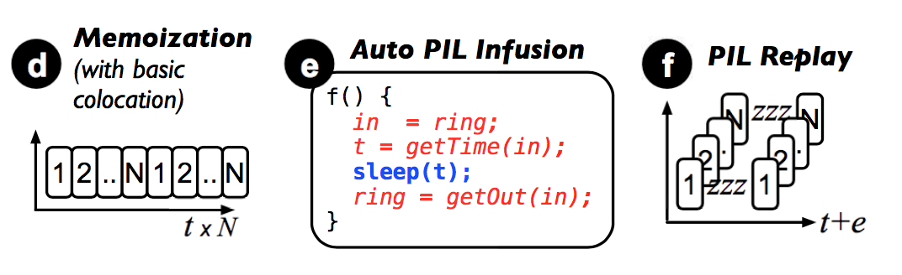
Future Work (Scale Bugs)
Automated tool

Slide 75
Conclusion
The complexity of cloud-scale hardware and software ecosystem has outpaced
existing testing, debugging, and verification tools.
Many new classes of bugs to hunt!
Need new techniques to combat them!
Notes:
And here is the conclusion that I want to tell every one.

Slide 76

Thank you! Questions?
http://ucare.cs.uchicago.edu

Slide 77
Extra

Slide 78
Scalability Bug Combating
Understanding, finding, testing and debugging
41 bugs in 7 systems
CPU, I/O, lock → cascading effects
Scalability bug checking

Slide 79
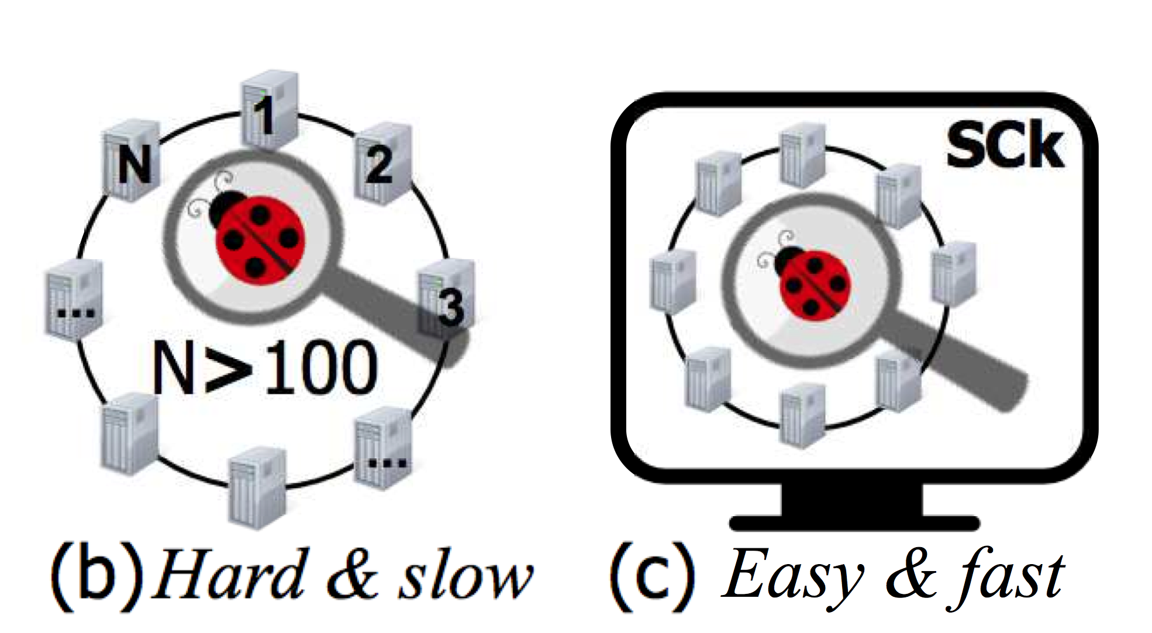
SCk Methodology
Methodology to scale-check distributed systems
Prior to deployment
… on just one machine
Resource contention

Slide 80
SCk Methodology
Finding offending functions
Pre-execute the functions to record output and execution time
Emulate large deployment one machine
Not execute the offending functions
Emulate execution time and output from pre-execution

Slide 81
Detailed Characteristics
ZooKeeper-1264
1. Follower F crashes, reboots, and joins cluster
2. Leader L sync snapshot with F
3. Client requests new update, F applies this only in memory
4. Sync finishes
5. Client requests other update, F writes this to disk correctly
6. F crashes, reboots, and joins cluster again
7. This time L sends only diff after update in step 5.
8. F loses update in step 3.
Notes:
The first thing I want to tell you is that.
Creating taxonomy is not straightforward.
I had to define new detailed characteristics that will help future dependability research.
And here are all characteristic that I studied

Slide 82
Detailed Characteristics
ZooKeeper-1264
1. Follower F crashes, reboots, and joins cluster
2. Leader L sync snapshot with F
3. Client requests new update, F applies this only in memory
4. Sync finishes
5. Client requests other update, F writes this to disk correctly
6. F crashes, reboots, and joins cluster again
7. This time L sends only diff after update in step 5.
8. F loses update in step 3.
Input:
- 4 Protocol
initiations
Notes:
The first thing I want to tell you is that.
Creating taxonomy is not straightforward.
I had to define new detailed characteristics that will help future dependability research.
And here are all characteristic that I studied
Creating taxonomy is not straightforward … but bug reports contain detailed descriptions .. Learn many things.
Let’s look one example

Slide 83
Detailed Characteristics
ZooKeeper-1264
1. Follower F crashes, reboots, and joins cluster
2. Leader L sync snapshot with F
3. Client requests new update, F applies this only in memory
4. Sync finishes
5. Client requests other update, F writes this to disk correctly
6. F crashes, reboots, and joins cluster again
7. This time L sends only diff after update in step 5.
8. F loses update in step 3.
Input:
- 4 Protocols
- 2 faults
- 2 reboots
Notes:
But after we run the systems, study protocols, read the source code and patches
we can define new detailed characteristics of the bugs which lead to this full tax- onomy.

Slide 84
Detailed Characteristics
ZooKeeper-1264
1. Follower F crashes, reboots, and joins cluster
2. Leader L sync snapshot with F
3. Client requests new update, F applies this only in memory
4. Sync finishes
5. Client requests other update, F writes this to disk correctly
6. F crashes, reboots, and joins cluster again
7. This time L sends only diff after update in step 5.
8. F loses update in step 3.
Timing:
- Atomicity
violation
- Fault Timing
Input:
- 4 Protocols
- 2 faults
- 2 reboots
Notes:
But after we run the systems, study protocols, read the source code and patches
we can define new detailed characteristics of the bugs which lead to this full tax- onomy.

Slide 85
TaxDC
Trigger
Error & Failure
Fix
Timing
Input
Scope
Order Violation
Atomicity Violation
Fault Timing
Reboot Timing
Fault
Reboot
Workload
Nodes
Messages
Protocols
Error
Failure
Loc Mem
Loc Sem
Loc Hang
Loc Silence
Glob Wrong
Glob Silence
Glob Miss
Downtime
Data Loss
Op Fail
Performance
Timing
Handling
Global Sync
Local Sync
Retry
Ignore
Accept
Others
Timing
Input
Scope
Error
Failure
Timing
Handling
What: First effect of
untimely ordering
Why: Help failure diagnosis
and bug detection
Notes:
Well, that is about the triggers. Now let me briefly talk about errors.

Slide 86

Trigger
Error
Local
Error can be observed
in one triggering node
(46%)
Null pointer,
false assertion,
etc.
Implication: identify opportunities for
failure diagnosis and bug detection
Notes:
Here we have local errors which are errors that we can see it by looking at a node that trigger happens.
46% have local error.
This means we can backward diagnose to root cause and build detection tools.

Slide 87

Trigger
Error
Local
Global
Error cannot be
observed in one node
(54%)
??
Many are silent errors and hard to diagnose
(hidden errors, no error messages, long debugging)
Notes:
But the rest is global which we need to look at other nodes to see errors.
And many of the bugs have hidden error which mean there is no error message. They are hard to diagnose and this creates long debugging.
So we need to think more about this.

Slide 88
Trigger
Timing
“How many reboots?”
Input
73% = No reboot
20% = 1
7%
Fault
Reboot
Notes:
And again we collect how many reboots too.

Slide 89
State of the Art
Partial order reduction
N1
N2
Brute force
ABCD
ABDC
ACBD
ACDB
ADBC
. . .
(24 total)
A B C D
N1: A B
N2: C D
A C B D
N1: A B
N2: C D
Same result
B
C
A
D
N3
No re-ordering of messages sent to different nodes

Slide 90
Black-Box Approach
Treat target systems as black boxes
Messages to the same node can be great
Model checkers are still slow
Not help in crashes & reboots
Black Box Model Checker
ABCD
ABDC
ACBD
ACDB
. . .
(24 total)
Black
Box
A
B
C
D
Notes:
The model checkers are slow because they treat the system as a black box.
What do I mean by that?
Let see this example, when we have a node with 4 concurrent messages, a model checker must permute all possible ordering as you can see here.

Slide 91
Why are model checkers slow?
Treat target systems as black boxes
Must re-order everything
Black Box Model Checker
ABCD
ABDC
ACBD
ACDB
. . .
(24 total)
Black
Box
A
B
C
D
Notes:
The model checkers are slow because they treat the system as a black box.
What do I mean by that?
Let see this example, when we have a node with 4 concurrent messages, a model checker must permute all possible ordering as you can see here.

Slide 92
Trigger
Timing
ZooKeeper-1264
1. Follower F crashes, reboots, and joins cluster
2. Leader L sync snapshot with F
3. Client requests new update, F applies this update only in memory
4. Sync finishes
5. Client requests other update, F writes this to disk correctly
6. F crashes, reboots, and joins cluster again
7. This time L sends only diff after update in step 5.
8. F loses update in step 3.
Input
Fault & reboot
2 crashes
2 reboots
Notes:
Come back to this bug again. This bug shows that DC bugs are NOT just about message re-ordering, but also about fault and reboot.
And not just 1 fault, 1 reboot, we need multiple. Like this bug, we need 2 crashes and 2 reboots to hit it.

Slide 93
Dev’s comments on DC bugs
“Do we have to rethink this entire [HBase] root and meta ’huh hah’? There isn’t a week going by without some new bugs about races between splitting and assignment [distributed protocols].” — hbase4397
“That is one monster of a race!” — mr3274
“This has become quite messy, we didn’t foresee some of this during design, sigh.” — mr4819
“Great catch, Sid! Apologies for missing the race condition” — mr4099
“We have already found and fix many cases ... however it seems exist many other cases.” — hb6147
Notes:
Highlights the importance in dealing with DC bugs

Slide 94
Research Contributions
Distributed concurrency bugs
SAMC: Semantic-aware model checking
TaxDC: DC bug taxonomy
Scalability bugs
SCk: Scale check methodology
Other
Limping hardware study
CBS: Cloud bug study
Drill-ready cloud
PBSE: Robust tail tolerance
OSDI ‘14 & ISSTA ‘15
ASPLOS ‘16
In submission
SoCC ‘13
SoCC ‘14
SoCC ‘14
In submission

Slide 95
AutoSAMC: Automated Semantic-Aware Model Checking for Real-World Distributed Concurrency Bugs [Future work]
Notes:
So the big question is how do we catch deep bugs in distributed systems?

Slide 96
Distributed System Model Checker
Event
Message
Crash
Multiple crashes
Reboot
Multiple reboots
Timeout
Computation
Disk fault
Modist NSDI’11 | Demeter SOSP’11 | MaceMC NSDI’07 | SAMC OSDI’14
Reality
Notes:
Right now, SAMC doesn’t address local computation timing, And also failure model SAMC uses is only node fail-stop and reboot.
My first next step is advancing SAMC to capture local computation and expand failure model.
The challenge here is this creates more events to re- order, and exacerbates state space explostion.
So I will create more generic reduction policies to mit- igate state space explosion.

Slide 97
Distributed System Model Checker
More distributed events & more failure models
Local computation, timeout exception, etc.
State space explosion!
More reduction policies & generic patterns
Automated semantic knowledge extracting
Burdensome &
error-prone
Current patterns
Discard pattern
Increment pattern
Constant pattern
Local impact pattern
Future work
More policies
Faster
More complicated
Harder
Easily extracted
Notes:
Right now, SAMC doesn’t address local computation timing, And also failure model SAMC uses is only node fail-stop and reboot.
My first next step is advancing SAMC to capture local computation and expand failure model.
The challenge here is this creates more events to re- order, and exacerbates state space explostion.
So I will create more generic reduction policies to mit- igate state space explosion.

Slide 98
AutoSAMC
More semantic reduction policies
Automated semantic knowledge extracting
By system analysis
Static (e.g. source code analysis)
Dynamic (e.g. runtime behavior analysis)

Slide 99
SAMC Architecture
SAMC
Protocol
Specific
Rules
Leader
Election
Atomic
Broadcast
…
…
Generic Reduction Policies
Local-Message
Indep. (LMI)
Crash-Message
Indep. (CMI)
Crash Recovery
Symmetry (CRS)
Samsung '17
Reboot Sync.
Symmetry (RSS)

Slide 100



Cloud Service Disruption
Wildly used in many companies
Facebook has 1,000-node cluster of Hadoop
Apple has 100,000 nodes of Cassandra
Problems in systems ➔ cloud service disruption
Massive Mail outage going on FOURTH days
Whoops - lose 1
billions photos
Creative Cloud
Has Been Down for Almost 24 Hours
Notes:
Add Amazon S3 outage on Mar 2017

Slide 101

Cloud Service Disruption
Collectively cost of billions of dollars each year
More than 40 online services down for 4 hours
Millions of dollars
Urgency in dependability research
AWS S3 outage is breaking
things for a lot of websites and apps
Feb 28, 2017

Slide 102
Vision
Uninterrupted computing!
Accessible any time / any where
Not lose / corrupt users’ data
Scale as user demand growing
Reasonable performance

Slide 103
Trigger
Timing
“How many reboots?”
Input
73% = No reboot
20% = 1
7%
Fault
Reboot
Notes:
And again we collect how many reboots too.

Slide 104
Trigger
Cassandra Paxos bug
(Cassandra-6023)
3 concurrent user requests!
“How many protocols to run as input?”
Timing
Input
Fault
Reboot
Workload
n
m
20% = 1
80% = 2+ protocols
p
o
Implication: multiple protocols
for DC testing
r
q
Notes:
Alright, I’ve told you that to get to the bugs, we need message ordering, and sometime faults and reboots.

Slide 105
Trigger
Cassandra Paxos bug
(Cassandra-6023)
3 concurrent user requests!
“How many protocols to run as input?”
Timing
Input
Fault
Reboot
Workload
n
m
20% = 1
80% = 2+ protocols
p
o
Implication: multiple protocols
for DC testing
r
q
Notes:
Well, the next input condtion is workload to excercise buggy code.
Let’s look at this Cassandra Paxos bug. Don’t worry the detail, but what happens is that M happens after N, O happens after P, and Q happens after R.

Slide 106
Detailed Characteristics
ZooKeeper-1264
1. Follower F crashes, reboots, and joins cluster
2. Leader L sync snapshot with F
3. Client requests new update, F applies this only in memory
4. Sync finishes
5. Client requests other update, F writes this to disk correctly
6. F crashes, reboots, and joins cluster again
7. This time L sends only diff after update in step 5.
8. F loses update in step 3.
Input:
- 4 Protocol
initiations
Notes:
Creating taxonomy is not straightforward … but bug reports contain detailed descriptions .. Learn many things.
Let’s look one example

Slide 107
Detailed Characteristics
ZooKeeper-1264
1. Follower F crashes, reboots, and joins cluster
2. Leader L sync snapshot with F
3. Client requests new update, F applies this only in memory
4. Sync finishes
5. Client requests other update, F writes this to disk correctly
6. F crashes, reboots, and joins cluster again
7. This time L sends only diff after update in step 5.
8. F loses update in step 3.
Input:
- 4 Protocols
- 2 faults
- 2 reboots
Notes:
But after we run the systems, study protocols, read the source code and patches
we can define new detailed characteristics of the bugs which lead to this full tax- onomy.

Slide 108
Detailed Characteristics
ZooKeeper-1264
1. Follower F crashes, reboots, and joins cluster
2. Leader L sync snapshot with F
3. Client requests new update, F applies this only in memory
4. Sync finishes
5. Client requests other update, F writes this to disk correctly
6. F crashes, reboots, and joins cluster again
7. This time L sends only diff after update in step 5.
8. F loses update in step 3.
Timing:
- Atomicity
violation
- Fault Timing
Input:
- 4 Protocols
- 2 faults
- 2 reboots
Notes:
But after we run the systems, study protocols, read the source code and patches
we can define new detailed characteristics of the bugs which lead to this full tax- onomy.

Slide 109


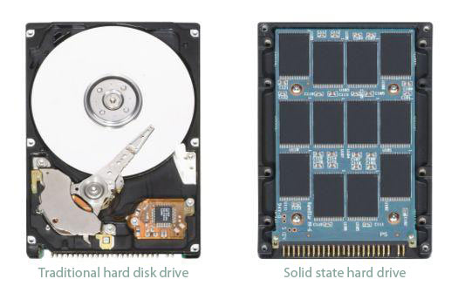
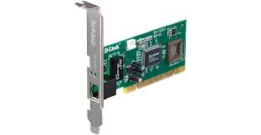

metadata
L
A
B
a | bc | c
X₁
X₁
New text
Some code
here
Alloc Req
ddafdafa
B
Some texts here
Test
Test

Slide 110
Unearthing Concurrency and Scalability Bugs In Cloud-Scale Distributed Systems
Tanakorn Leesatapornwongsa
Advisor: Haryadi S. Gunawi
Committee: Shan Lu, Ravi Chugh

Slide 111
Message Processing Semantic in a Leader Election
Ballot = n3
B = 3
B = 3
B = 3
if(vote <= ballot)
// do nothing
else
ballot = vote;
V = 1
V = 2
V = 4
B = 3
B = 3
B = 4
Vote=1
Vote=2
Vote=4
Notes:
So how can we find independent events? Message processing semantic will help us here.
Consider this example of simplified leader election protocol.
When a leader election takes place, every node has its own ballot which the node wants to choose as a leader.

Slide 112
Removing Duplicated Re-ordering
1, 2, 3
1, 3, 2
2, 1, 3
Ballot=4
B = 4
B = 4
B = 4
V = 1
V = 1
V = 2
Vote=1
Vote=2
Vote=3
B = 4
B = 4
B = 4
. . .
Unnecessary
V = 2
V = 3
V = 1
if (vote <= ballot)
// do nothing
else
ballot = vote;
B = 4
B = 4
B = 4
V = 3
V = 2
V = 3
B = 4
B = 4
B = 4
Notes:
So how does message processing semantic helps us here?
Well lets imagine the ballot is 4, and the node is re- ceiving votes 1, 2, 3.
If we know the message processing semantic ahead of time, instead of reordering every possibility like this, we can PREDICT that these reorderings are unnec- essary, because IN EVERY STEP, YOU CAN SEE THAT the node does not change the state

Slide 113
Crash-Message Independence
L
void handleCrash() {
if (X == follower && isQuorum())
followerCount--;
// No new messages
}
Black Box
ABCDX
ABCXD
ABXCD
AXBCD
XABCD
ABDCX
…
A,B
C,D
F
F
F
L
Crash a follower
→ Local Impact
(no new messages &
only state changes in leader L)
A,B
C,D
F
F
F
Notes:
Look at replication protocol in this leader-follower ar- chitecture.
What happen if we crash the follower and there are outstanding messages ABCD to the other followers?

Slide 114
Dev’s comments on DC bugs
“Do we have to rethink this entire [HBase] root and meta ’huh hah’? There isn’t a week going by without some new bugs about races between splitting and assignment [distributed protocols].” — hbase4397
“That is one monster of a race!” — mr3274
“This has become quite messy, we didn’t foresee some of this during design, sigh.” — mr4819
“Great catch, Sid! Apologies for missing the race condition” — mr4099
“We have already found and fix many cases ... however it seems exist many other cases.” — hb6147
Notes:
Highlights the importance in dealing with DC bugs

